Slide 1







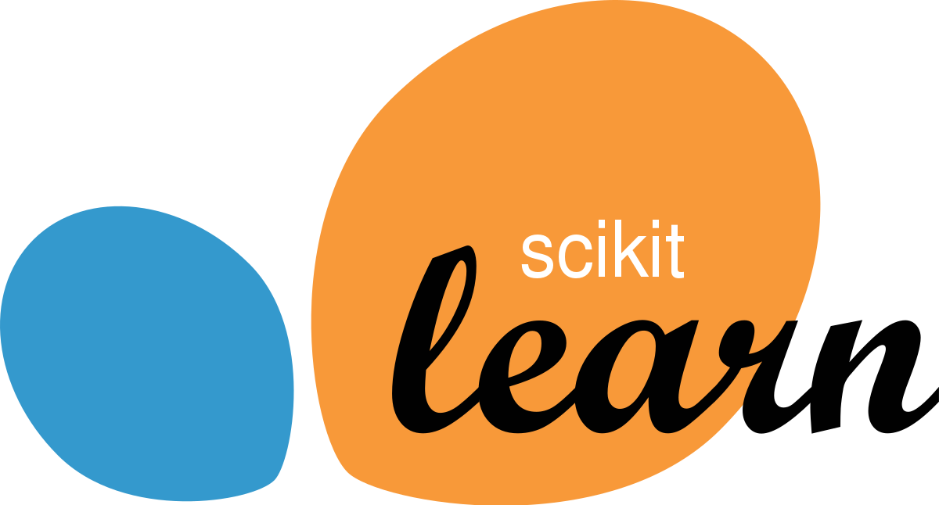


AI Master Class Series –
Day – 4/30
தமிழ்
Moving Object Detection | Computer Vision

Slide 2
OpenCV Examples
01
Installing Python and Configuring Environment variables

Slide 3
Image Resize.
import cv2
import imutils
img = cv2.imread(‘sample2.jpg')
resizedImg = imutils.resize(img, width=500)
cv2.imwrite(‘resizedImage.jpg', resizedImg)

Slide 4
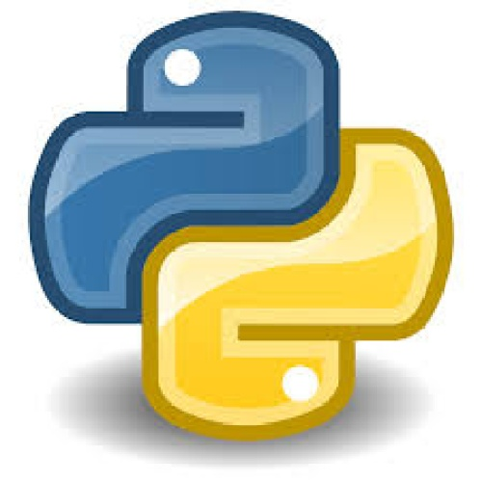

Gaussian Blur - Smoothening
import cv2
img = cv2.imread(‘sample2.jpg')
grayImg = cv2.cvtColor(img, cv2.COLOR_BGR2GRAY)
#dst = cv2.GaussianBlur(src, (kernel),borderType)
gaussianImg = cv2.GaussianBlur(grayImg, (21, 21), 0)
cv2.imwrite(“GaussianBlur.jpg”, gaussianImg)

Slide 5
threshold
#dst = cv2.threshold(src, threshold, maxValueForThreshold,binary,type)[1]
import cv2
img=cv2.imread("sample.jpg")
grayImg = cv2.cvtColor(img,cv2.COLOR_BGR2GRAY)
gaussBlur = cv2.GaussianBlur(grayImg,(21,21),0)
thresholdImg = cv2.threshold(grayImg,150,255,cv2.THRESH_BINARY)[1]
cv2.imwrite("threshold.jpg",thresholdImg)

Slide 6
Drawing Rectangle.
#cv2.rectangle(src,startpoint,endpoint,color,thickness)
cv2.rectangle(img, (x, y), (x + w, y + h), (0, 255, 0), 2)
Putting Text in Image.
#cv2.putText(src, text, position,font,fontSize,color,thickness)
cv2.putText(img, text, (10, 20), cv2.FONT_HERSHEY_SIMPLEX, 0.5, (0, 0, 255), 2)

Slide 7
findContours.
#dst =cv2.findContours(srcImageCopy, contourRetrievalMode, contourApproximationMethod)
cnts = cv2.findContours(threshImg.copy(), cv2.RETR_EXTERNAL, cv2.CHAIN_APPROX_SIMPLE)

Slide 8
Moving Object Detection
02
Hands-on

Slide 9
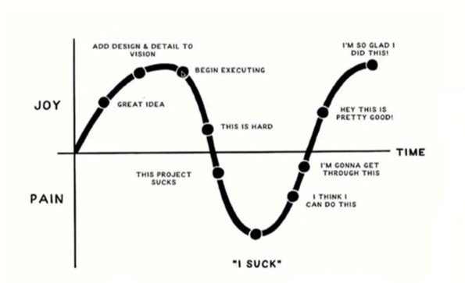
🧠Mindset of the Day💡

Slide 10
Thanks

